Slide 1
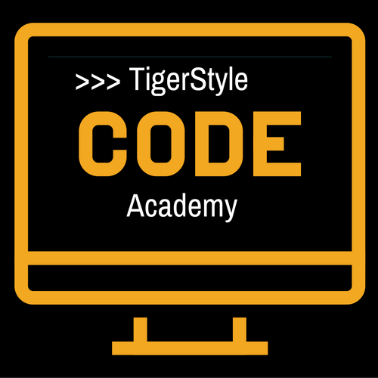
Python web scraping Tutorial - 2
2 – Our First Web Scraper
TigerStyle Code Academy

Slide 2
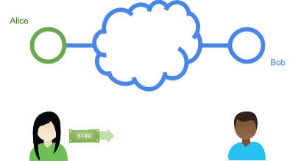
Our First Web Scraper
Connecting
Alice (web server) – Bob (desktop)
Process:
Bob’s PC → bits of 1 and 2
Bob’s router receives the bits
Bob’s packet → servers
Alice server receives packet
Alice server reads the packet
Web server app receives stream of data
Get request
Index.html
Web server locates the correct HTML file
INTERNET

Slide 3
Scrapetest.py
HTML code
http://pythonscraping.com/pages/page1.html
page1.html → <web root>/pages → http://pythonscraping.com
Image files, JavaScript files, CSS files
<img src=“cuteKitten.jpg”> → cuteKitten.jpg

Slide 4
Urllib or urllib2
Urllib2 - Python2.x
Urllib – Python 3.x
Urllib.request
Urllib.parse
Urllib.error

